Slide 1
Task 2. Spotting mosquito habitats
Goal: Individual’s will be able to highlight key problem areas for mosquito growth.
Materials Needed:
--Survey Data Worksheets
Guidelines and Research:
Individuals will be able to identify a mosquito lifecycle, which includes the habitats that mosquitoes live in and need for reproduction. They will then complete an initial physical and biological assessment of their field site using a data collection form. During this initial survey, individuals will also note potential mosquito breeding habitats.

Slide 2
Task 2. Spotting mosquito habitats
First look at the mosquito stoppers descriptions.
1. Considering the property of your residence, develop a list of areas you think are potential breeding habitats for mosquitoes.
* Breeding habitats can include natural and man-made water bodies (e.g. trash, tires, play structures, potted plants, etc).
3. Take your site survey form and note both biological and non-biological features of the sites you have selected. Regarding site ID please provide the street address (note: this information will only be used to map mosquito habitats). Also mark down the number and type of potential mosquito breeding habitats.

Slide 3
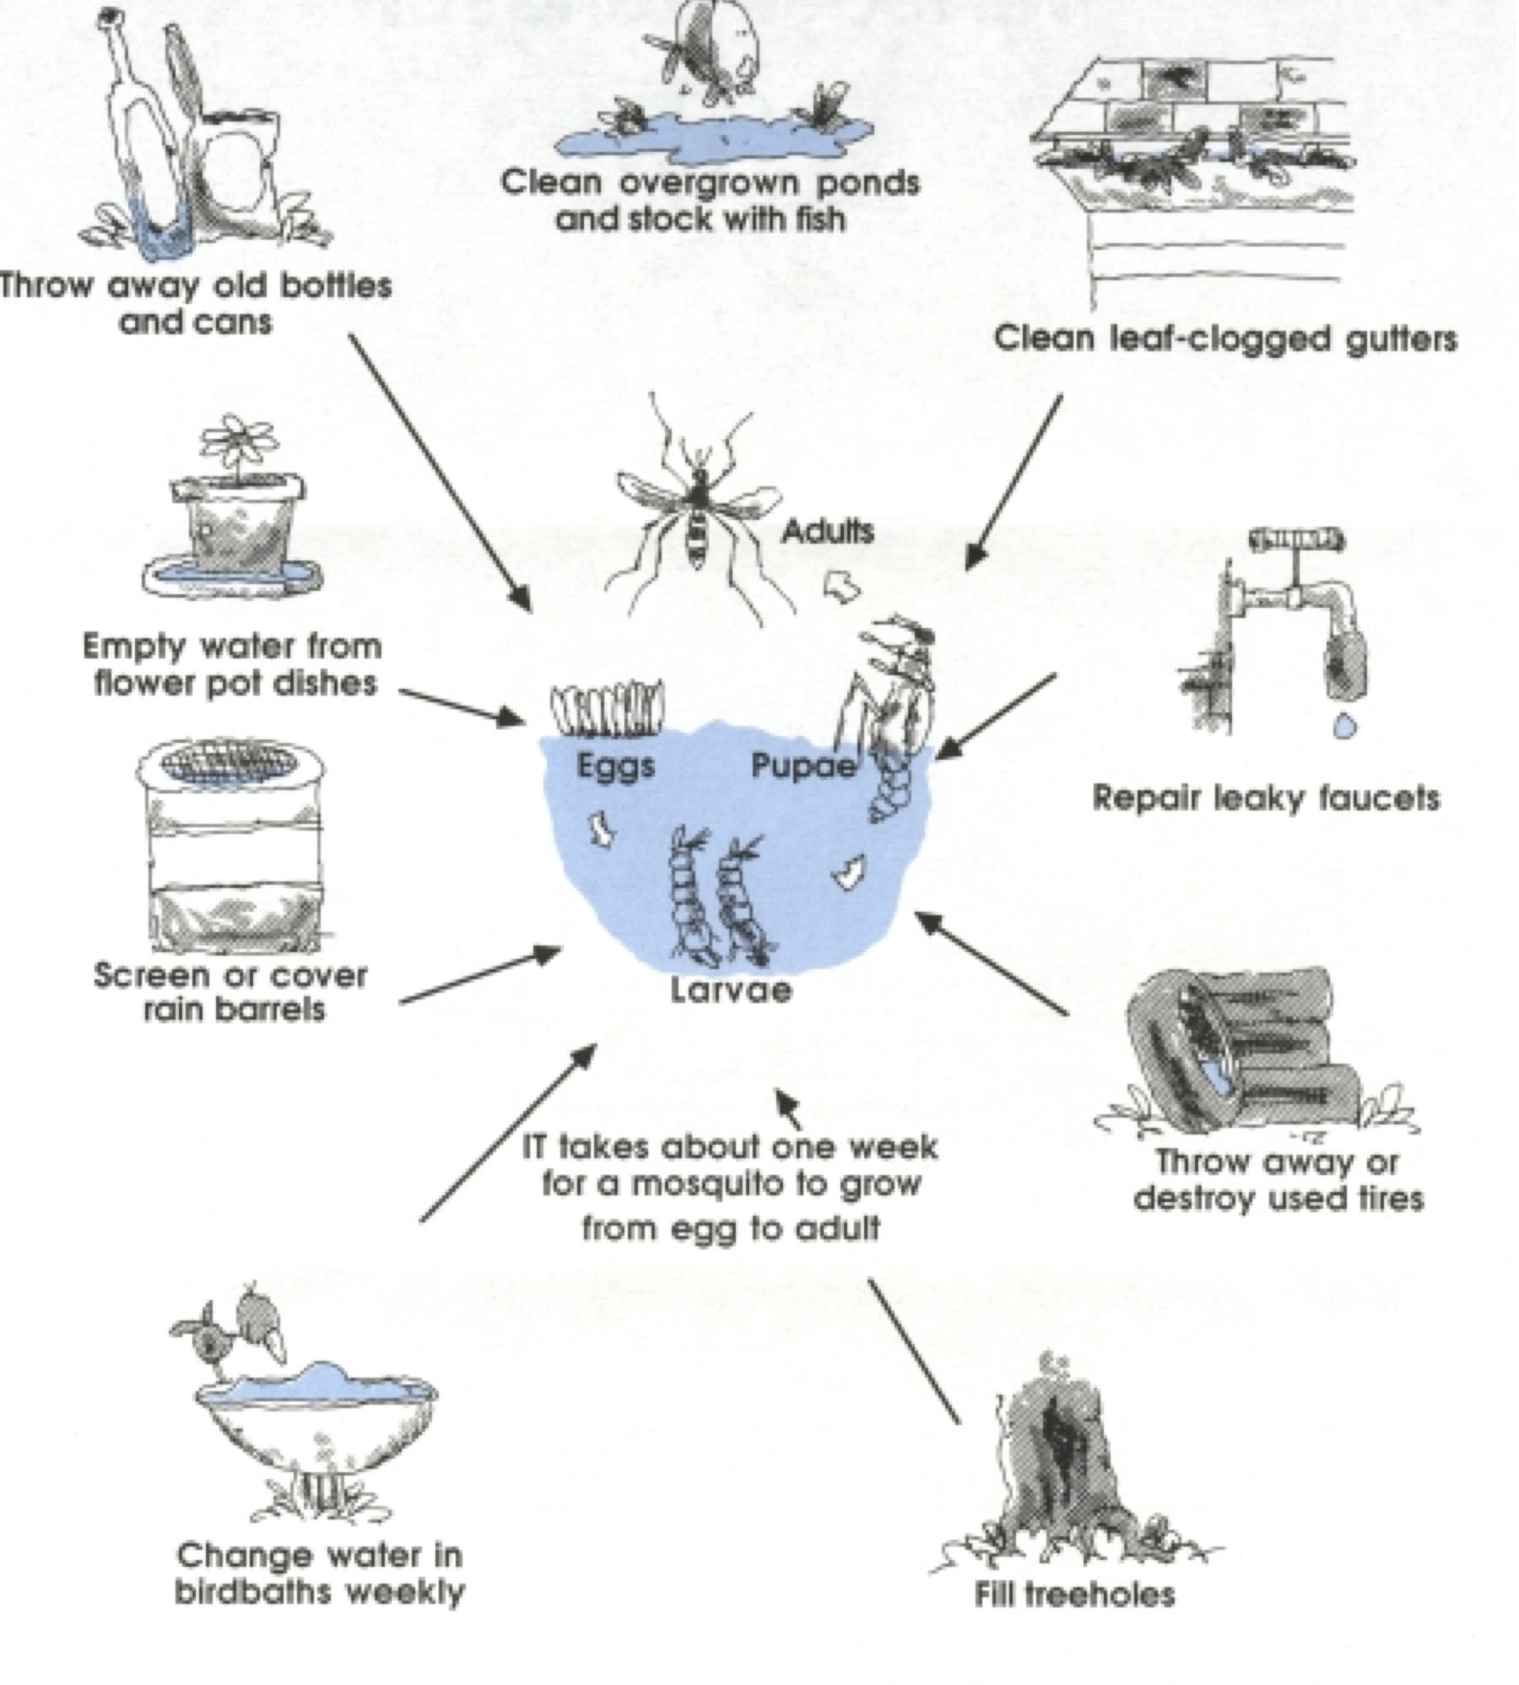
Task 1. Mosquito Habitats
Mosquito Habitats

Slide 4
Task 2. Spotting mosquito habitats
(take multiple sheets)
Site ID: _____________________________________________
Site within yard | Air Temp (F) | Water Presence? (Y/N) | Habitat diameter | Habitat Type | Physical Notes | Biological Notes

